Slide 1
APRENDIZAJE AUTOMÁTICO
Carlos Andres Ferro Sanchez, PhD.

Slide 2
Class methodology
Lectures:
Presentación en español
Slides in English
UAO virtual
Software:
Python
Google Colaboratory (Colab)
Scikit-learn library
TensorFlow
Projects
Defined by students

Slide 3
Syllabus and time-line
First project delivery: Day 7 Final test: Day 15
Project Delivery and presentation: Day 16
Lecture 1: Introduction. Why ML? Why Python?. Fundamental concepts of machine learning and applications. A first application: Classifying Iris species
Lecture 2: Supervised learning, Generalization, Overfitting, and Underfitting. Suppervised machine learning algorithms - k-Nearest Neighbors, Linear models
Lecture 3: Unsupervised learning and preprocessing. Types of unsupervised learning,
challenges, preprocessing and scaling. Dimensionality reduction, feature extraction
Lecture 4: Representing data and engineering features
Lecture 5: Decision trees, Ensembles of decision trees,
Lecture 6: K-means, Agglomerative clustering, DB-SCAN
Lecture 7: Intro to DL, machine learning projects and pipelines

Slide 4
Evaluation
Homeworks and quizzes
Test
Project first delivery
Project final delivery
10%
30 %
20 %
30 %

Slide 5
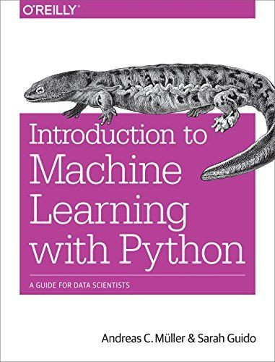
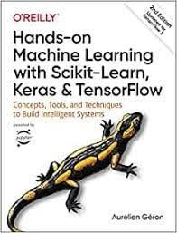
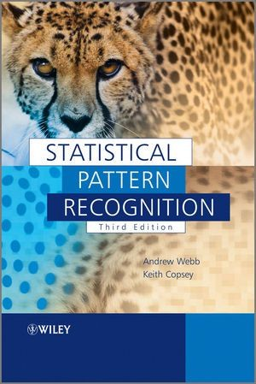
Bibliography
Introduction to machine learning with python
Hands-On Machine Learning with Scikit-Learn, Keras, and TensorFlow: Concepts, Tools, and Techniques to Build Intelligent Systems
Statistical Pattern Recognition Andrew R. Webb John Wiley & Sons. 2004

Slide 6

INTRODUCTION TO MACHINE LEARNING (ML)

Slide 7
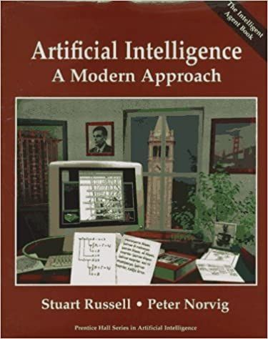
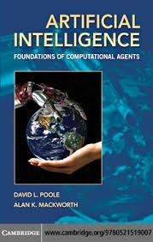
What is AI?
The study of "intelligent agents": any device that perceives its environment and takes actions that maximize its chance of successfully achieving its goals.
Intelligent agents/machines = human-like machines?

Slide 8
Human-like Artificial Intelligence
Experts like Yann LeCun expect AI to do more than see and hear: Reason and take action autonomously
Reasoning: the ability to make inferences
Inference: a conclusion reached on the basis of
evidence (from Oxford Languages)
Taking action: do something official or concerted to achieve an aim or deal with a problem (from Oxford
Languages)
https://getpocket.com/explore/item/this-is-how-the-robot-upr ising-finally-begins

Slide 9
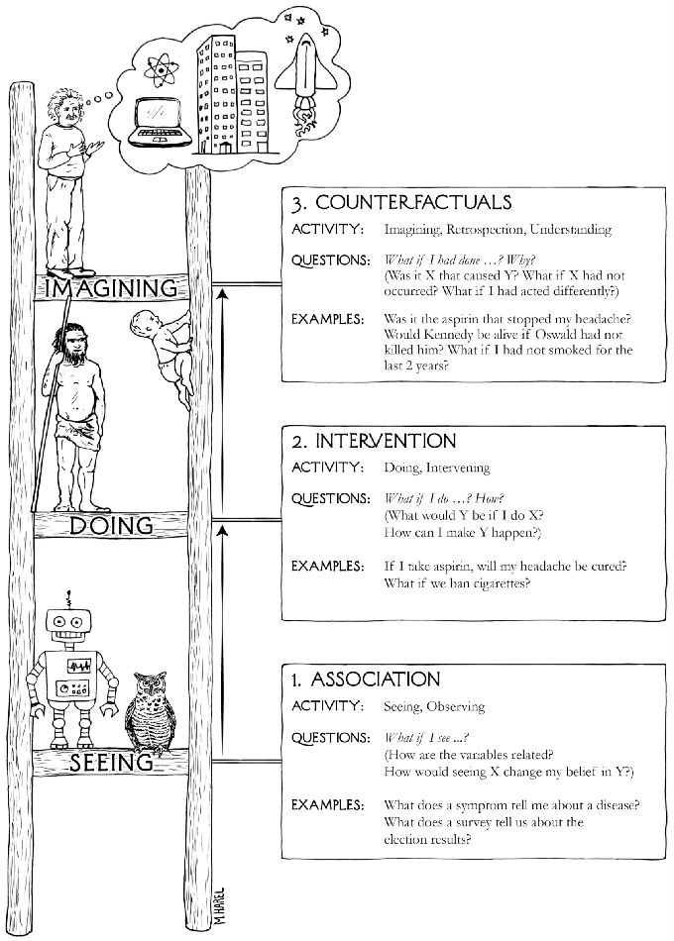
Causal inference
Replace reasoning by association with causal reasoning: Cause and effect
Machine Learning!
Source: The book of why. Judea Pearl, 2018

Slide 10
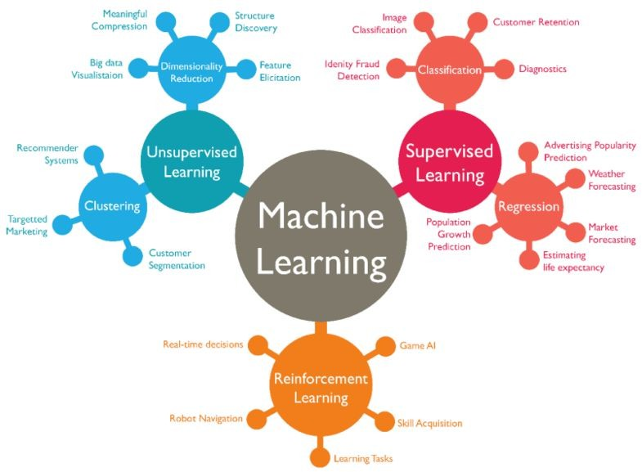
https://www.sharper.ai/wp-content/uploads/2018/10/Ma chineLearning-BubbleChart-awahid-gleetech.png

Slide 11
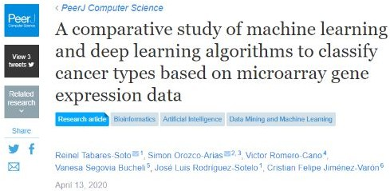
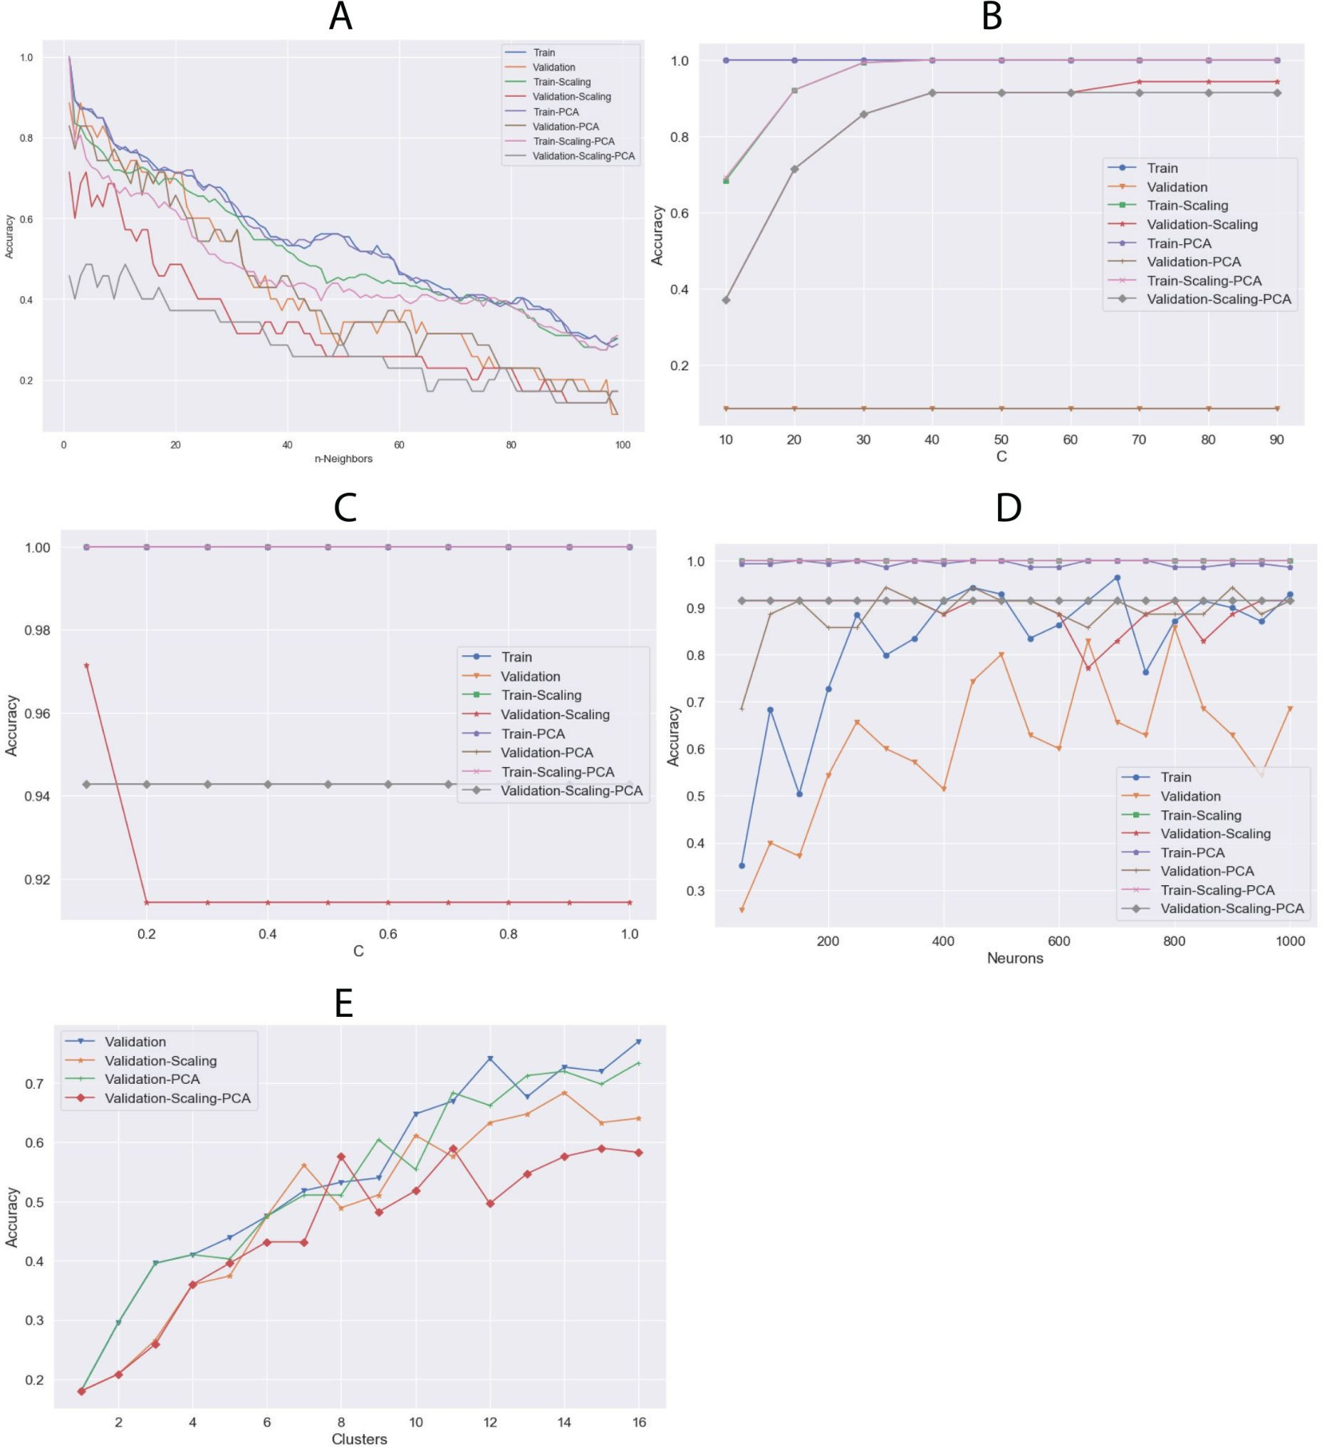

Slide 12
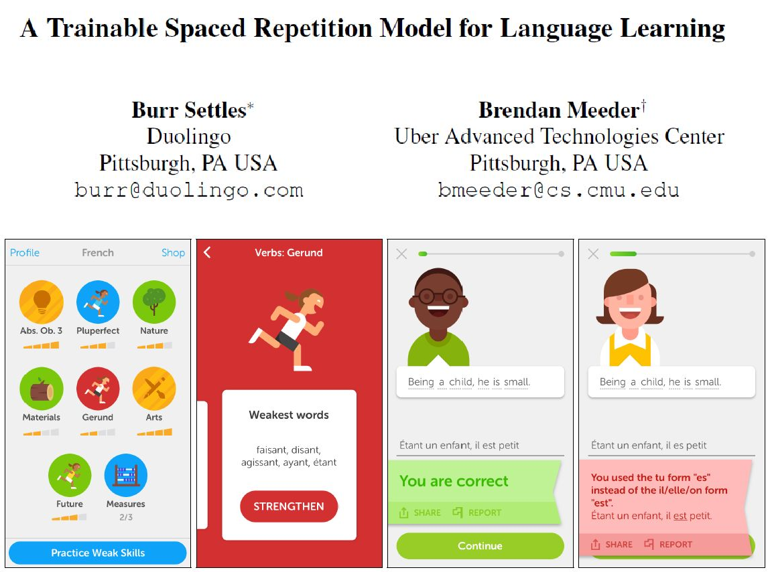


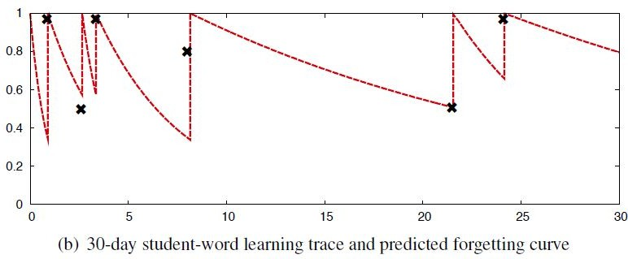
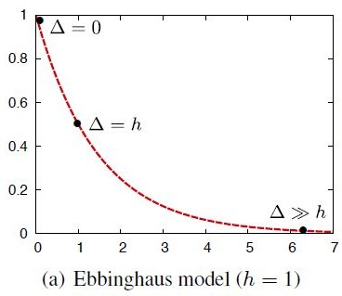


Slide 13
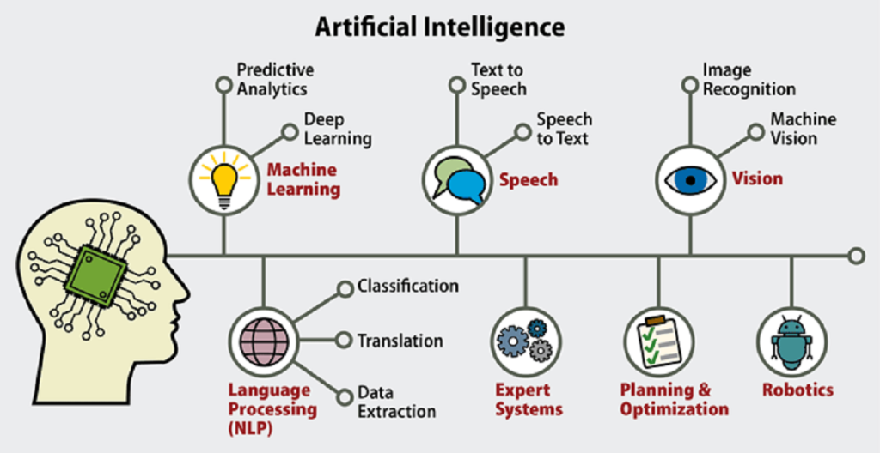
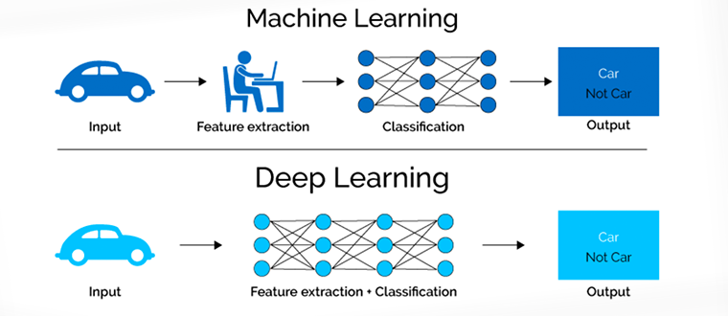
Artificial Intelligence, Machine Learning and Deep Learning
https://theedugarage.com/2020/05/25/artificial-intelligence/
http://blog.thinkwik.com/insights-of-the-machine-learning-and-the-deep-learning/

Slide 14
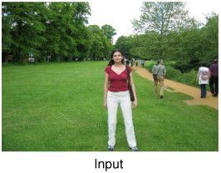
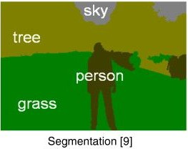
Machine Learning (ML) - definition
Machine learning is the subfield of computer science that gives computers the ability to learn without being explicitly programmed (Arthur Samuel, 1959). Taken from wikipedia.
It’s about extracting knowledge from data
Machine learning algorithm
Data
knowledge

Slide 15
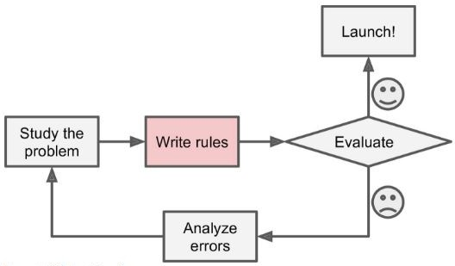
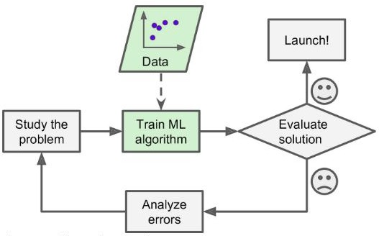
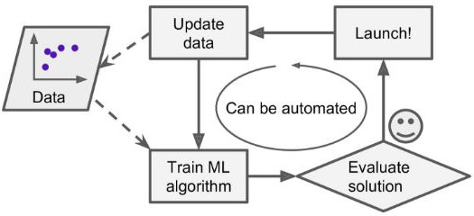
Why you should use ML? Efficiency and accuracy

Slide 16
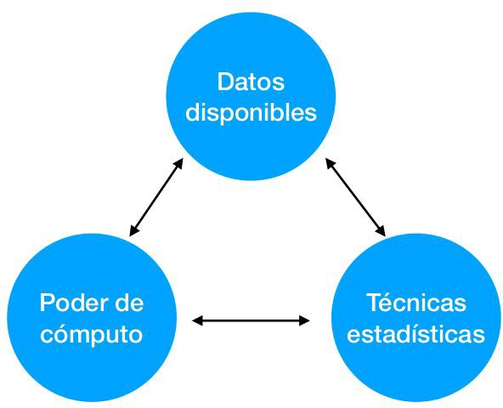
Main resources required for ML implementation

Slide 17
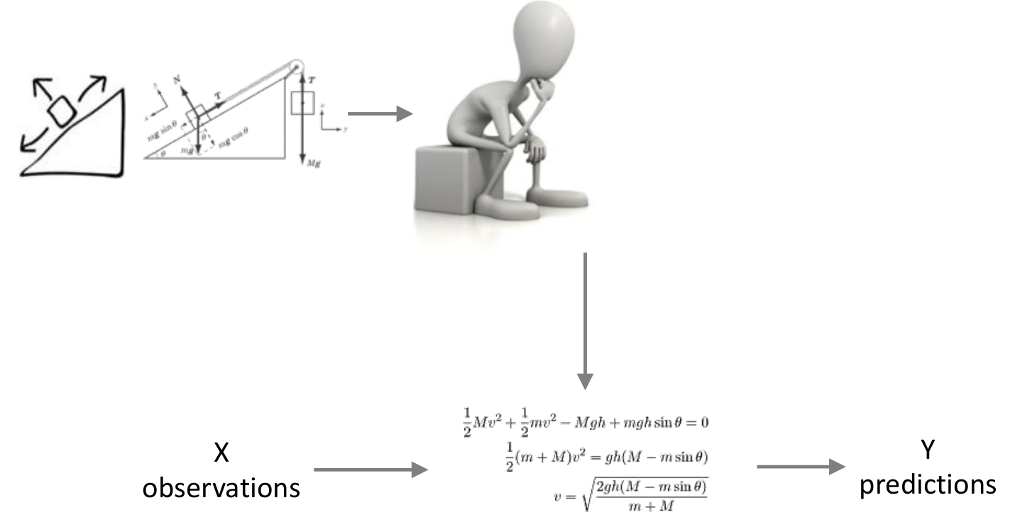
From Observations to Predictions through Models Introduction to Machine Learning
Observations → Predictions
Patient image → has pathology
Text fragment → sentiment
Financial time series → value trend
House description → market value
Client profile → product to buy
Analytical Models
Se trata de crear modelos
X
Observations
Predictor variables
Independent variables
Features
Modelo
Y
Predictions
Target variables
Dependent variables
Labels

Slide 18
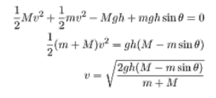
From Observations to Predictions through Models Introduction to Machine Learning
X → y
Example data
New X
Model Creation
Model
Predictions y

Slide 19
From Observations to Predictions through Models Introduction to Machine Learning
X → y
Example data
X news
Template Model
Calibrated Model
Modelo
y predictions

Slide 20
From Observations to Predictions through Models Introduction to Machine Learning
VALIDATION DATA
TRAINING DATA
Separated data for model calibration
X, y not seen during training → measure generalization capacity
X → y
Example data
Available data → (X, y) pairs
X new
Template Model
Calibrated Model
Modelo
y predictions

Slide 21
From Observations to Predictions through Models Introduction to Machine Learning
Type of Error | Training Performance | Validation Performance | Main Cause
Underfitting | ❌ Poor | ❌ Poor | Model too simple or insufficiently trained
Overfitting | ✅ Good | ❌ Poor | Model too complex or over-trained
Good Fit | ✅ Good | ✅ Good | Well-calibrated and balanced model

Slide 22
Model Deployment
Model Refinement
07
Model Evaluation
Model Training
06
01
Data Preprocessing
05
02
Data Exploration
04
03
Data Collection

Slide 23
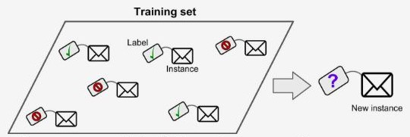
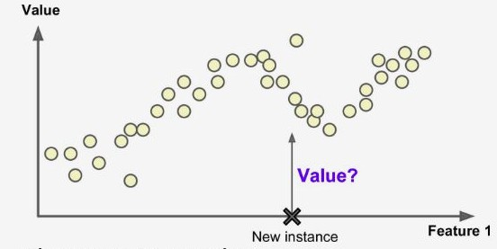
Supervised Learning
Learning: Input (features)/ output → algorithm → model
Inference: model / input → algorithm → output
− Classification
– Regression: Predict a target numeric value Price of a car,

Slide 24
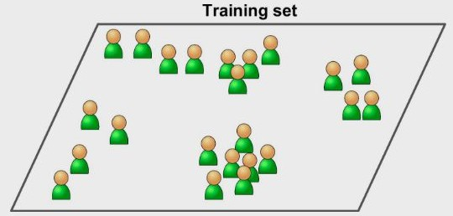
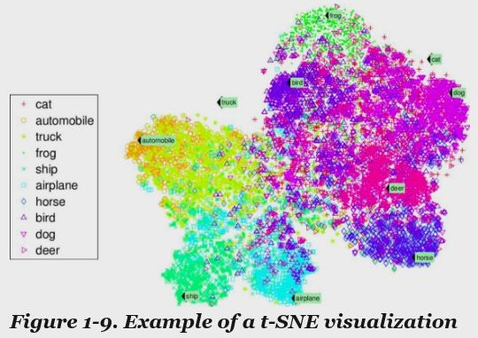
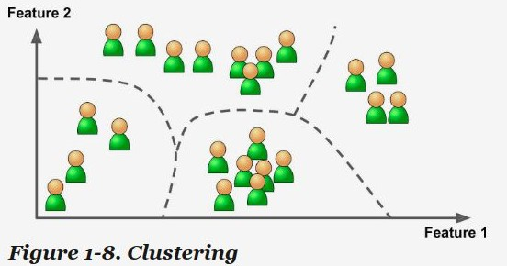
Unsupervised Learning
Unsupervised learning
Learning: Input → algorithm → model
Inference: model / input → algorithm → output
Clustering
− Dimensionality reduction: Visualization

Slide 25
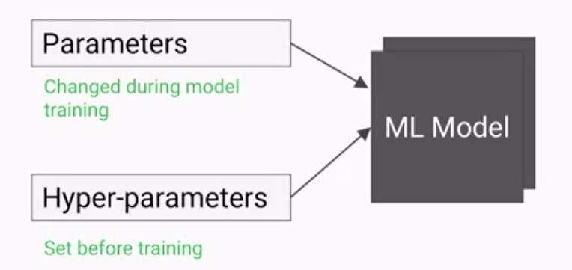
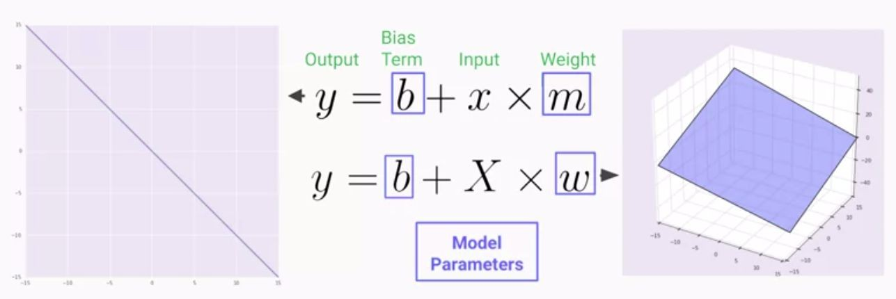
ML models are mathematical functions with parameters and hyper-parameters

Slide 26
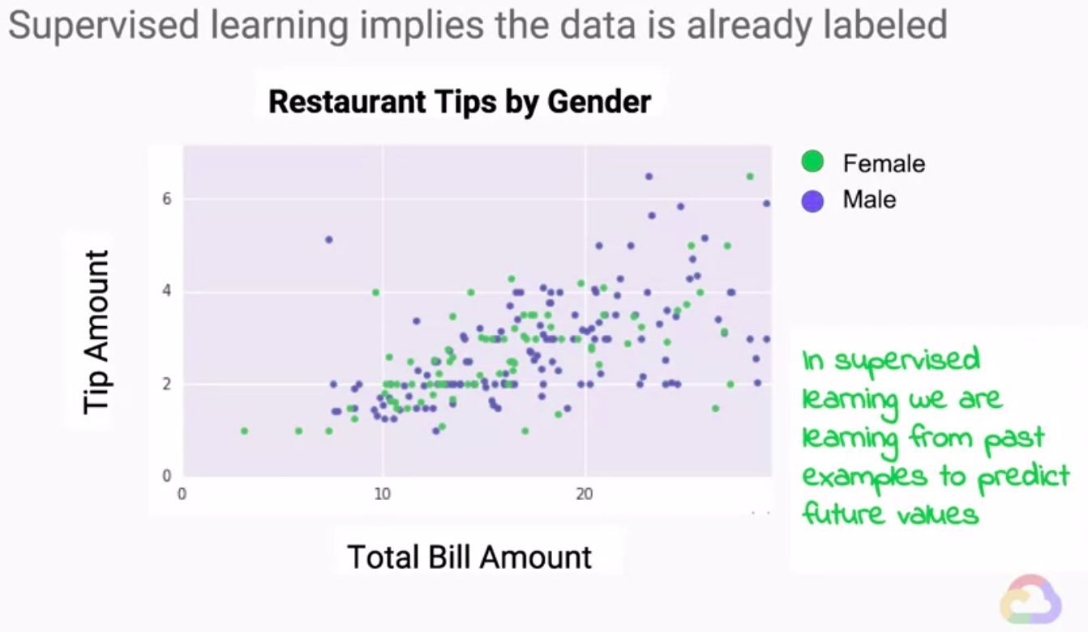

Slide 27
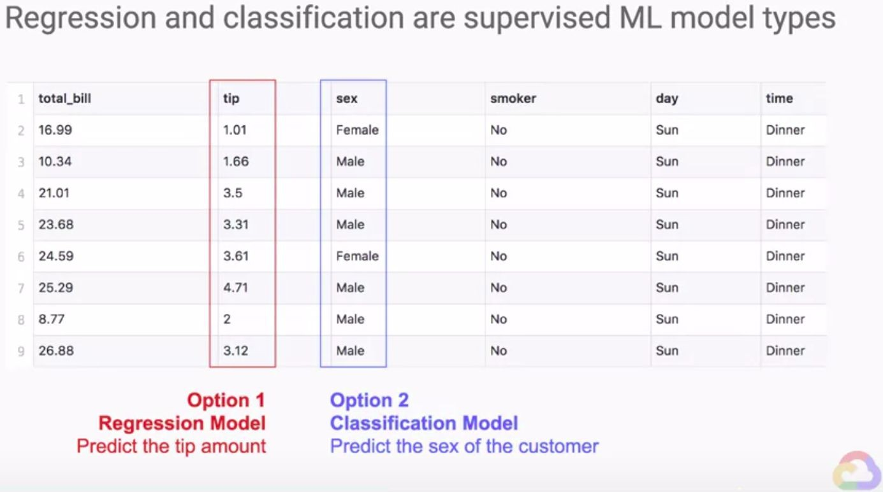

Slide 28
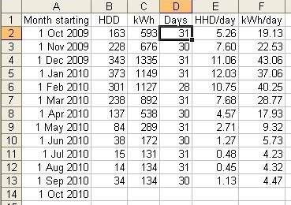
So… what is data?
Think of data as a table
Each data point (sample) is a row
Each property (feature) that describes that data point is a column

Slide 29
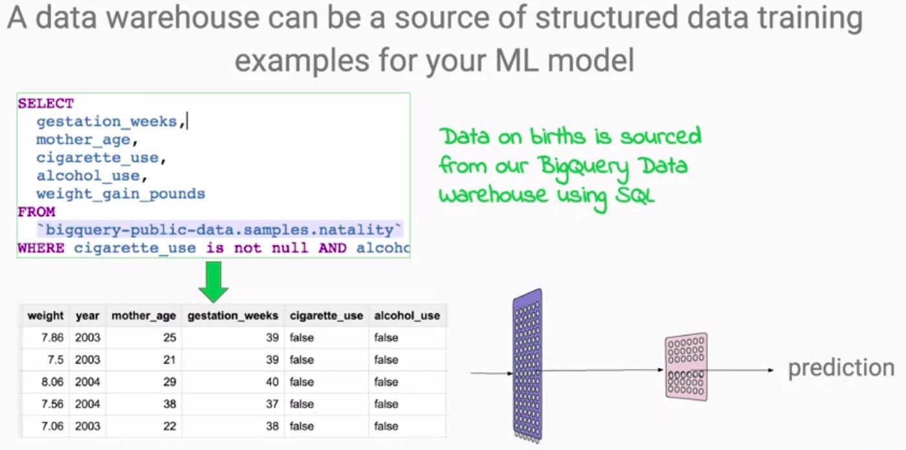
Where does data come from?

Slide 30
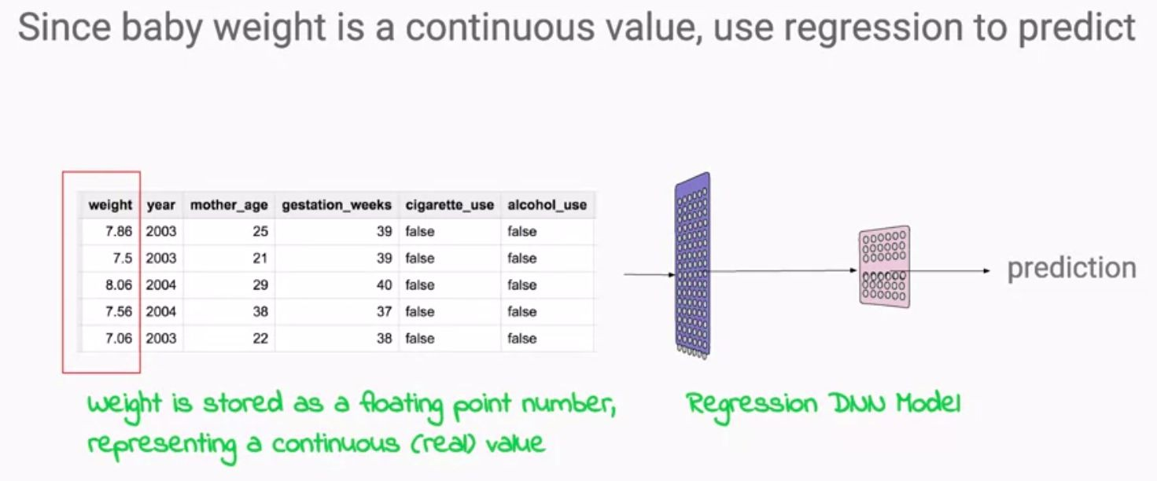

Slide 31
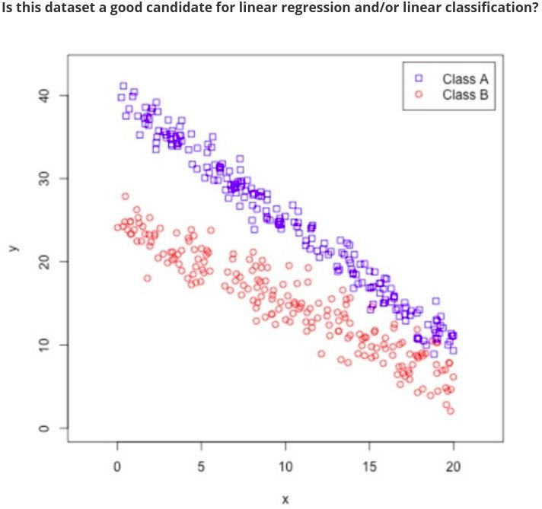
LR
LC
Both
None

Slide 32
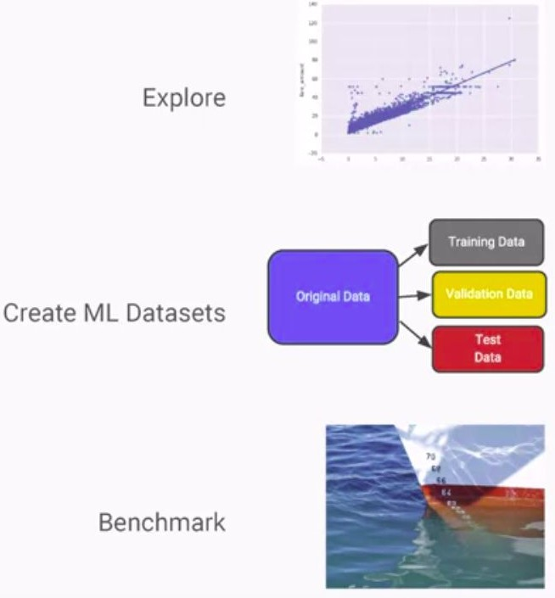
How to get started with a ML problem?
What is the question am I trying to answer?
What is the best way to phrase my question(s) as a machine learning problem?
Have I collected enough data to represent the problem I want to solve?
How will I measure success in my application?
How will the machine learning solution interact with other parts of my research or business product?
– Yes: Let’s do machine learning!

Slide 33


Python
Lingua franca for many data science applications
It combines the power of general-purpose programming languages with the ease of use of domain-specific scripting languages like Octave or R
Has libraries for data loading, visualization, statistics, natural language processing, image processing, and more
This is not a Python/programming class

Slide 34


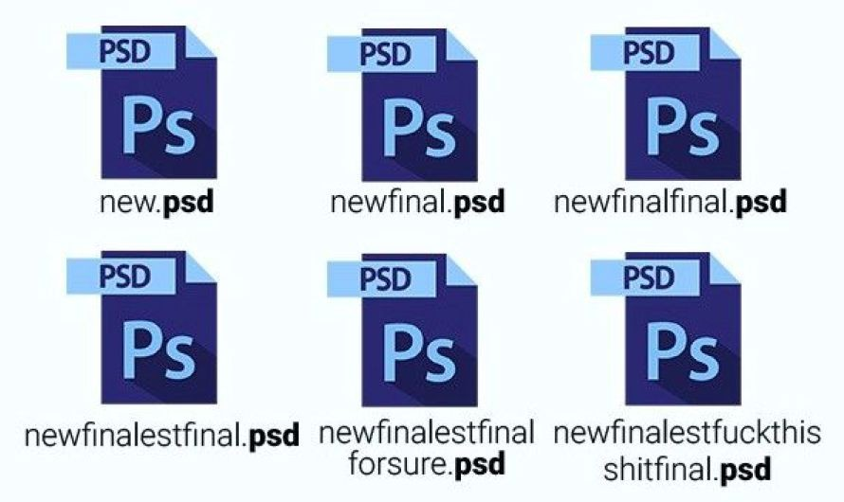
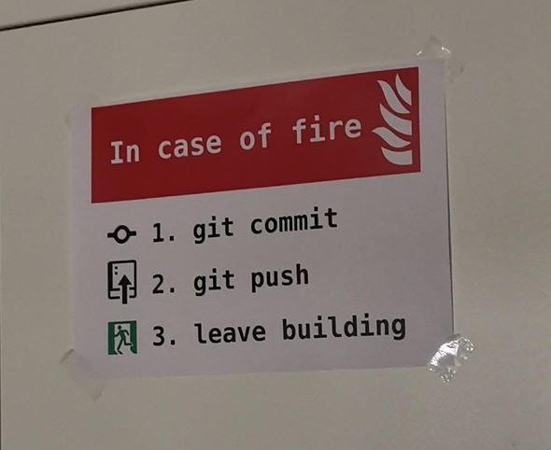
Git and GitHub
https://github.com/manueldiaz96/git_class

Slide 35
Homework
Get started with Kaggle and become a Contributor
https://www.kaggle.com/alexisbcook/getting-started-with-kaggle?utm_medium= email&utm_source=gamma&utm_campaign=thirty-days-of-ml&utm_content=day
-1
Kaggle tutorials:
How Models Work?
https://www.kaggle.com/dansbecker/how-models-work?utm_medium=email&ut m_source=gamma&utm_campaign=thirty-days-of-ml&utm_content=day-8
Basic Data Exploration
https://www.kaggle.com/dansbecker/basic-data-exploration?utm_medium=email &utm_source=gamma&utm_campaign=thirty-days-of-ml&utm_content=day-8

Slide 36
References
Introduction to machine learning with python
Hands-On Machine Learning with Scikit-Learn & TensorFlow
Coursera course: Launching into Machine Learning
https://towardsdatascience.com/saving-the-scranton-br anch-with-lead-scoring-8599ed4a874f

